Slide 1
Session goals
Session goal 1 (Theoretical Tutorial)
Overview key steps of a NLP project.
Data Preprocessing
TFIDF
Word2vec, doc2vec
Transformer based text generator
Session goal 2 (Lab session)
NLP Classification
Build a (Valentine) Excuse Bot
Notes:
This slide is required. Do NOT delete. This should be the first slide after your Title Slide.
This slide should describe what your goals are for this session. This information lets your audience know what you are trying to accomplish with your talk or tutorial—ie, what value will attendees get by investing 25 minutes or 2 hours of their time listening to you.
You should not spend more than 1 minute presenting this slide.
General examples of session goals could be (you will have to create your own specific goals):
Introduce a new technique or approach to solve a customer problem
Compare two approaches and explain why one is superior
Describe a project and the learnings that audience members can apply from it
Teach audience members how to use a specific technology

Slide 2
Agenda
Theoretical Part
Introduction of NLP pipeline
NLP data preprocessing
TF-IDF
Word2vec, Doc2Vec
BERT
Transformer-based text generation
Code Lab:
Learn how to do NLP classification
Build a Valentines’ Day Excuse Bot

Slide 3
Environment
Anaconda 3 (Python 3.5+)​
Keras (+ Tensorflow backend)​
Gensim​
NLTK​
pytorch
Transformers
sklearn
Github link

Slide 4
Overview and NLP data preprocessing

Slide 5
Key steps of a NLP project
1. Data Cleaning
2. Vectorization
3. Finalize features
4. Classification or text generation.

Slide 6
NLP Data Cleaning
Problem-specific task, e.g. remove the words that don’t provide you any signal
Remove numbers
Remove punctuation​
Remove stop words (“the”, “a”, “in”, etc)
Lemmatization: reducing the derived words to the root form by considering the morphological analysis of the words. You will have detailed dictionaries which the algorithm can look through to link the form back to the right words, e.g. “studies”, “studied” to “study”

Slide 7
Introduction to text embedding

Slide 8
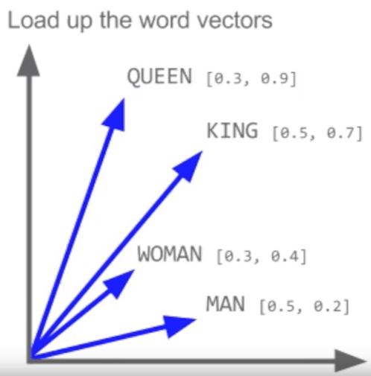
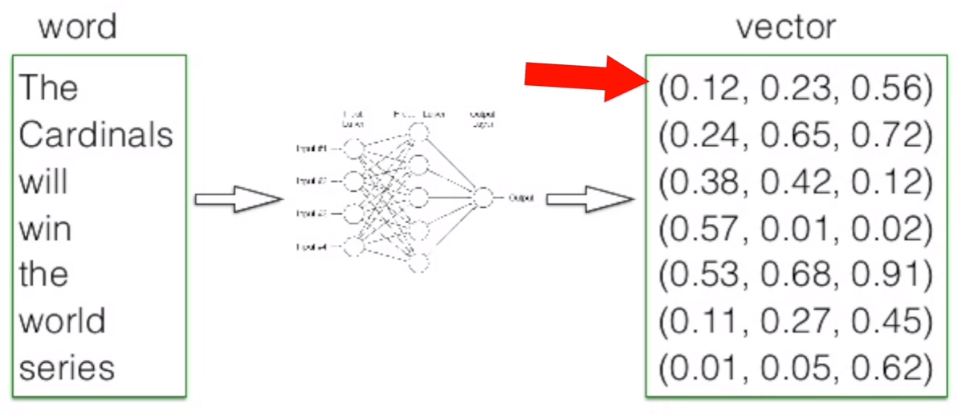
What's text embedding?
The text embedding transforms text into a numerical representation (an embedding) with a fixed length and ideally the vectors represents the semantic similarities.
http://www.lifestyletrading101.com/word2vec-deep-learning/

Slide 9
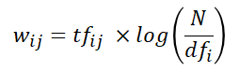
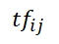
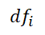
TF-IDF
Frequency-based method
TF-IDF
: number of occurrences of i in j
number of documents containing i
N: total number of documents

Slide 10
TF-IDF
Pros: help us to understand the content and easy to interpret.
Cons:
The vector in general is too long, particularly a long article.
The word context could be a problem.

Slide 11
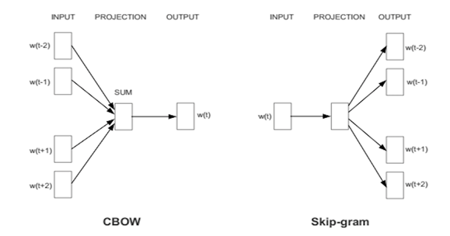
Neural network-based methods – word2vec/doc2vec

Slide 12
Transformer-based method – BERT

Slide 13
The key limitation of the earlier models
For example, " I went to the bank for a deposit" and “there is a nice bench on the bank of the river”.
For each word, there is one numerical representation. They gnore the context and cannot handle scenarios of the same words but with different meanings.

Slide 14
BERT introduction
Data: Wikipedia (2.5B words) + BookCorpus (800M words)
Pretrained models
BERT-Base, Uncased: 12-layer, 768-hidden, 12-heads, 110M parameters
BERT-Large, Uncased: 24-layer, 1024-hidden, 16-heads, 340M parameters
BERT-Base, Cased: 12-layer, 768-hidden, 12-heads , 110M parameters
BERT-Large, Cased: 24-layer, 1024-hidden, 16-heads, 340M parameters
Trained on multiple TPUs for several days.
BERT enable pretrained deep bidirectional representations.
BERT performance:
Set new standard for 11 language tasks!

Slide 15
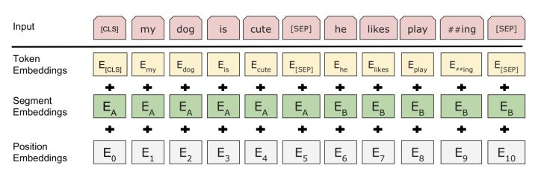
Model input

Slide 16
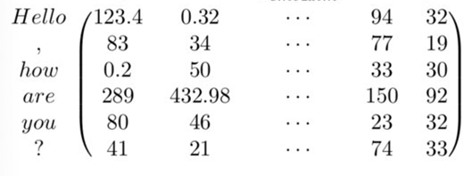
Model input - continued
Token embedding:
Method: WordPiece Method (Wu et al 2016)
Goal: transform words into vector representations of fixed dimension.
Each word is represented as a 768-dimensional vector.
Position Embedding: allows model to learn relative positioning.
Segment Embedding: index at sentence level .
My home is not close SEP I need to visit my parents.
0 0 0 0 0 0 1 1 1 1 1 1

Slide 17
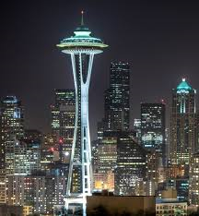


Attention
Attention from image analysis perspective.
In NLP context, attention is to figure out the relationship of tokens of sentences.

Slide 18
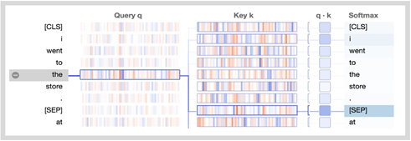
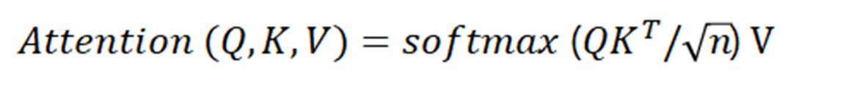
BERT self-attention
Query q: the word “querying” the other words. In the example blow, the query vector for “the” (the selected word) is highlighted.
Key k: the key vector k encodes the word on the right to which attention is being paid.
scaling
https://towardsdatascience.com/deconstructing-bert-part-2-visualizing-the-inner-workings-of-attention-60a16d86b5c1

Slide 19
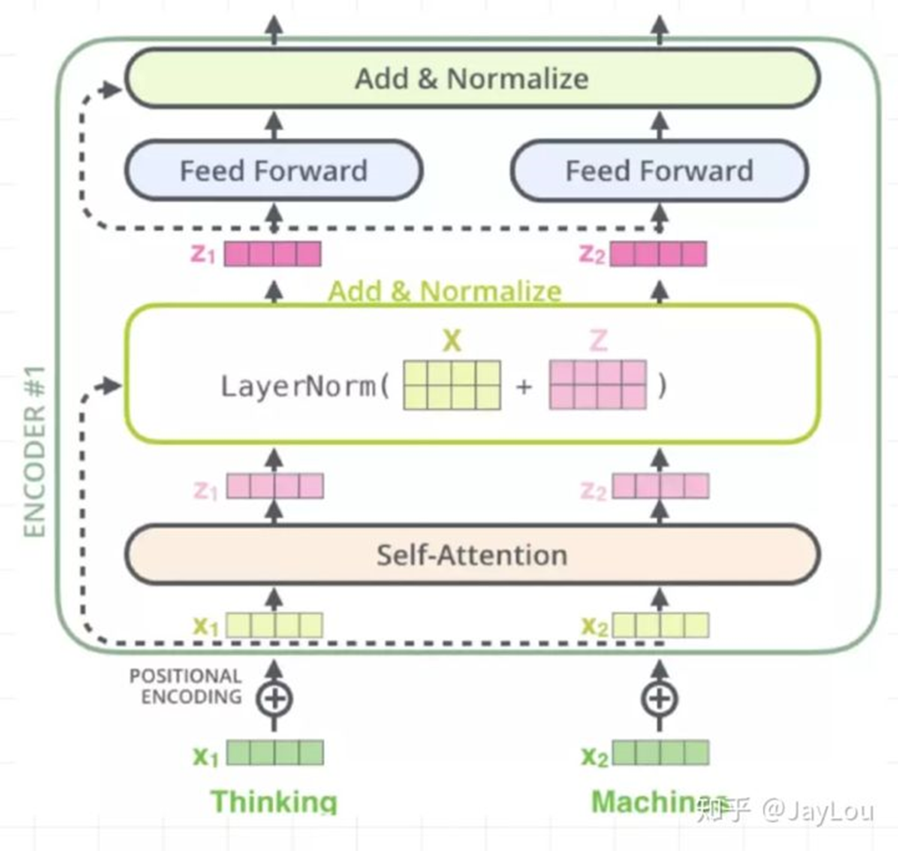
BERT: Multi-layer bidirectional Transformer encoder
Input embedding= token embedding + position embedding + segment embedding.
Multi-head self attention
Residual connection and layer normalization
Feed-forward layers (gelu activation function)
layer_norm(attention_output + layer_input)

Slide 20
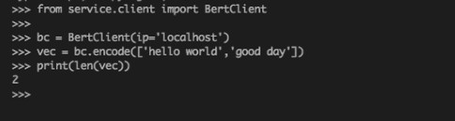
BERT feature embedding code
Cosine similarity rank is suggested to be used instead of the raw score.

Slide 21
BERT classification
Uniﬁed architecture across different tasks:
BERT can be used for a wide variety of language tasks by adding a layer to the core model.
Binary Classification Example:
output_weights = tf.get_variable("output_weights", [num_labels, hidden_size], initializer=tf.truncated_normal_initializer(stddev=0.02))
#hidden_size = output_layer.shape[-1].value;
# num_labels=len(label_list) #how many categories of your outcome data
output_bias= tf.get_variable("output_bias", [num_labels], initializer=tf.zeros_initializer())
output_layer = tf.nn.dropout(output_layer, rate=0.1)
logits = tf.matmul(output_layer, output_weights, transpose_b=True)
logits = tf.nn.bias_add(logits, output_bias)
log_probs = tf.nn.log_softmax(logits, axis=-1) #log probability.
one_hot_labels = tf.one_hot(labels, depth=num_labels, dtype=tf.float32)
#compute loss between predicted and actual label
per_example_loss = -tf.reduce_sum(one_hot_labels * log_probs, axis=-1)
loss = tf.reduce_mean(per_example_loss)
Details are seen: https://github.com/bryan-c-castillo/MLADS-TextEmbedding-Bert-Elmo-Tutorial

Slide 22
Text generation – build a Valentine's Day Excuse Bot

Slide 23
Lab example
MDB Dataset​ for classification tasks
50K highly polarized reviews​
Built a Valentine Excuse Bot
Lab:
Vectorize the reviews using tf-idf
Vectorize the reviews using doc2vec
Built a Valentine Excuse Bot

Slide 24
References
Luhn, Hans Peter (1957). "A Statistical Approach to Mechanized Encoding and Searching of Literary Information" (PDF). IBM Journal of Research and Development. 1 (4): 309–317.
Spärck Jones, K. (1972). "A Statistical Interpretation of Term Specificity and Its Application in Retrieval". Journal of Documentation. 28: 11–21.
Laham, D. (1997). Latent Semantic Analysis Approaches to Categorization. Proceedings of the 19th Annual Conference of the Cognitive Science Society (p. 979). Hillsdale, NJ: Lawrence Erlbaum Associates, Inc.
Mikolov, Tomas; Sutskever, Ilya; Chen, Kai; Corrado, Greg S.; Dean, Jeff (2013). Distributed representations of words and phrases and their compositionality. Advances in Neural Information Processing Systems.
Quoc Le, Tomas Mikolov . Distributed Representations of Sentences and Documents. Proceedings of the 31st International Conference on Machine Learning, PMLR 32(2):1188-1196, 2014.
P. Bojanowski*, E. Grave*, A. Joulin, T. Mikolov, Enriching Word Vectors with Subword Information
Wu et al: Google’s Neural Machine Translation System: Bridging the Gap between Human and Machine Translation
Ashish Vaswani, et al. “Attention is all you need.” NIPS 2017
Devlin, Jacob et al. Pre-training of Deep Bidirectional Transformers for Language Understanding. arXiv preprint arXiv:1810.04805, 2018

